Slide 1


Counting Techniques
MATH 30-6
Probability and Statistics

Slide 2
OBJECTIVES
At the end of this lesson, the students are expected to :
Define Probability
Use Counting Techniques
Relate counting techniques to real life situations

Slide 3
PROBABILITY
Tool to relate the descriptive statistics to inferential statistics.
Ratio of number of samples derive from the total population
Deals With counting elements

Slide 4
SETS
Set is a collection of predefined elements designated by capital letters.
Roster Method or Listing Method
The method describes the set by listing all elements of the set separated by commas and enclosed in braces { }.
If D is the set of vowels in the alphabet, then .
If B is the set of counting numbers between 2 and 7, then .
If P is the set of letters in the word ELEMENT, then .

Slide 5
SETS
Set is a collection of predefined elements designated by capital letters.
Rule Method or Set-Builder Notation
The method describes the set by enclosing a descriptive phrase of the elements in braces.
If D is the set of vowels in the alphabet, then .
If B is the set of counting numbers between 2 and 7, then .
If P is the set of letters in the word ELEMENT, then .

Slide 6
CARDINALITY OF SETS
Cardinality is the number of elements in the given set.
Examples:
If D is the set of vowels in the alphabet, then the cardinality is.
If B is the set of counting numbers between 2 and 7, then the cardinality is.
If P is the set of letters in the word ELEMENT, then the cardinality is.
The cardinality of a set S, denoted by n(S) , is the number of distinct elements in the set.

Slide 7
SAMPLE SPACE
ACCORDING TO THE NUMBER OF ELEMENTS:
Examples:
Number of days in a month Number of students in a class
Number of hours it take to study Time it takes to sleep
Number of heads that appears in a toss of 6 coins
Red Spades in a deck of card
Pregnant Male
A finite sample space is a set whose elements can be counted; otherwise, the set is an infinite sample space.
A null or empty set, denoted by { } or φ , is a set that has no element. The universal set, denoted by U, is a set that contains all the elements in consideration.

Slide 8
SET RELATIONSHIP
Equivalent and Equal Sets
A one-to one correspondence exists between two sets A and B if it is possible to associate the elements of A with the elements of B in such a way that each element of each set is associated with exactly one element of the other.
Two sets A and B are equivalent, denoted by if and only if there exists a one-to-one correspondence between them.
Two sets A and B are equal, denoted by if the elements of A and B are exactly the same.

Slide 9
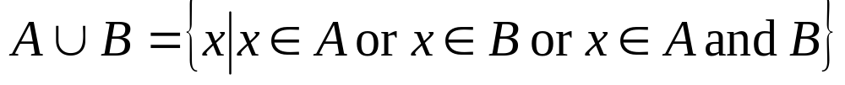
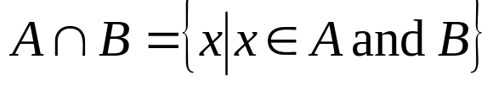
SET OPERATIONS
Union of Sets
Intersection of Sets
The union of two sets A and B, denoted by A ∪ B , is the set whose elements belong to A or to B or to both A and B. In symbol,
The intersection of two sets A and B, denoted by A ∩ B , is the set whose elements belong to both A and B. In symbol,

Slide 10
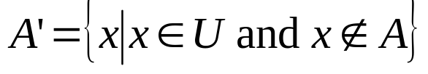

SET OPERATIONS
Complement of Sets
Difference of Sets
The complement of set A, denoted by A’, is the set with elements found in the universal set, but not in A; that is, the difference of the universal set and A. In symbol,
The difference of two sets A and B, denoted by , is the set whose elements are in A but not in B, In symbol,

Slide 11
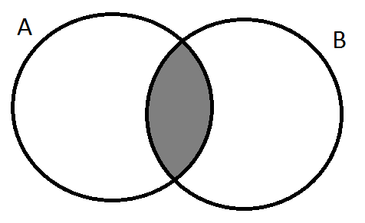
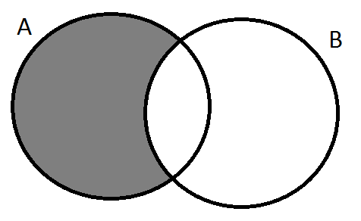
VENN DIAGRAM
Venn Diagram
Pictorial representation of sets composed of overlapping circles inside a rectangle.
The rectangle represent the Sample Space
The circles represent Subsets of the Sample Space.
U
A
U
U
A
B
U

Slide 12
VENN DIAGRAM
A survey of 100 students revealed the following information as to the number of students enrolled in Mathematics (M), Physics(P) and Chemistry(C):
Subject Number of students enrolled
M 26
C 65
P 65
M and C 14
M and P 13
C and P 40
M, C and P 8
a) How many students are taking any one of the three subjects?
b) How many students did not take any of the three subjects?
c) How many students are enrolled only in Mathematics?
d) How many students are enrolled only in Chemistry?
e) How many students are enrolled only in Physics?

Slide 13
VENN DIAGRAM
1. In a survey concerning the number of students enrolled in Mathematics, it was found out that 30 are enrolled in Algebra, Calculus and Trigonometry; 40 in Algebra and Trigonometry; 45 in Trigonometry and Calculus; 50 in Algebra and Calculus; 80 in Algebra; and 70 in Calculus. If there are 130 students in all, how many students are enrolled in Trigonometry?
2. In a survey among moviegoers’ preferences, 60% like fiction, 55% like drama, 56% like comedy, 25% like fiction and drama, 30% like fiction and comedy, 26% like comedy and drama, and 5% like fiction, drama and comedy. Only 5% of the respondents do not prefer any types of movies mentioned.
What are the percentages of moviegoers who prefer
comedy but not fiction? d. drama only?
b. fiction or comedy but not drama?
c. comedy and drama but not fiction?

Slide 14
TREE DIAGRAM
A tool of listing down the elements of the sample space.
Example:
In buying a drink, Marco has a choice of juice, softdrink or alcoholic beverage. Each has an option to be ice cold or warm and can either be served in a glass, plastic cup, a bottle or a ceramic mug. How many options does he have for his drink?
In his memorial plan, Mr. Macapagal has a choice to either wear Filipiniana or Corporate attire; be Cremated or buried; played by classical music, OPM, church song or kundiman. How many choices can his family set for his burial?

Slide 15
COUNTING TECHNIQUES
Techniques used to count the number of elements for each event.
MULTIPLICATION RULE
Consists of multiplying the number of possible outcome on independent events
PARTITIONING
Consists of adding separate events in the sample space.

Slide 16
MULTIPLICATION RULE
In how many ways can a meal composed of 3 main course, 5 appetizers, 3 soups and 6 desserts be made, if each meal is composed of one of each dish?
Toss a die six times, how many outcomes are possible?
Flip a coin twice and roll a die three times, how many outcomes are possible?

Slide 17
PARTITIONING
Flip a coin, if the outcome is a head, roll a die twice otherwise three times. How many outcomes are possible?
Choose a letter from the alphabet, if it as vowel flip a coin twice, otherwise roll a die thrice. How many outcomes are possible?

Slide 18
PERMUTATIONS
arrangement of all or part of a set of objects.
a. Factorial
b. Permutation
c. Circular Permutation
d. Permutation with repetition

Slide 19
FACTORIAL
If all of the elements are to be arranged in a certain order the number of permutations can be obtained by simple multiplication rule
abc bac cab
acb bca cba
Factorial (n!)
The factorial (!) of a certain whole number is defined as:
n! = n(n-1)(n-2)(n-3)…3(2)1

Slide 20
FACTORIAL
In how many ways can 3 boys and 3 girls sit in a row?
(b) In how many ways, if the boys must sit together?
(c) In how many ways, if no two people of the same sex is allowed to sit together?

Slide 21
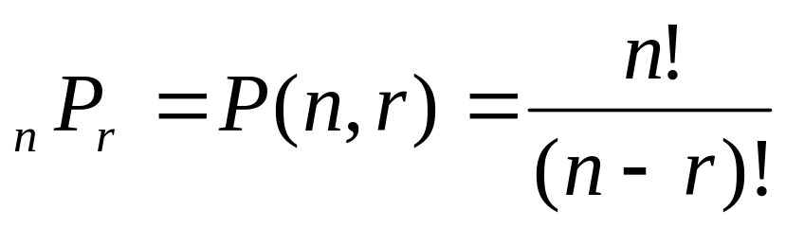
PERMUTATION
Arrangement of selected few elements in a row.
The number of permutations of n objects taken r at a time is

Slide 22
PERMUTATION
In how many ways can a family of six be seated in a mini-bus consisting of 20 chairs?
In how many ways can the top 10 students be selected from a class of 20 students?
In how many ways can the set of Class officers of 6 positions be selected from a class of 40 students. B. If Mary would only be vicepresident if John is the President

Slide 23
CIRCULAR PERMUTATION
Arrangement in a circle
The number of permutations of n distinct objects arranged in a circle is
(n – 1)!

Slide 24
CIRCULAR PERMUTATION
In how many ways can the 12 knight be arranged in a round table?
In how many ways can 20 individuals ride a ferris wheel
how many ways can 10 children play “Dr. Quack Quack”

Slide 25
CIRCULAR PERMUTATION
In how many ways can 5 couples be seated in a circle?
If the wives insist on sitting next to his husband.
If the husband insist on sitting opposite his wife?

Slide 26
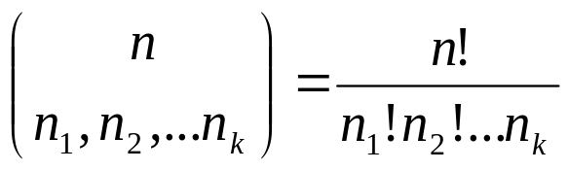
PERMUTATION WITH REPETITION
Consider the case when the objects to be arranged are not all distinct
The number of distinct permutations of n objects of which n₁ are of the first kind, n₂ of a second kind,…n_{k} of a kth kind is

Slide 27
PERMUTATION WITH REPETITION
How many different letter arrangements can be made from the letters
PROPOSE ?
PALAWAN ?
ARRANGE ?
How many different signals, each consisting of 6 flags hung in a vertical line, can be formed from 4 identical red flags, and 2 identical blue flags?
A child has 12 blocks of which 6 are black, 4 are red, 1 is white, and 1 is blue. If the child puts the blocks in a line, how many arrangements are possible?

Slide 28
COMBINATION
1. A group of 7 individuals went to Baguio, on their trip to Baguio, they used different vehicles. A tricycle which can carry 3 passengers, a mini- car which can carry 4 individuals , a Big Bike which can carry 2 passengers. In how many ways can they go to Baguio using all the vehicles?

Slide 29
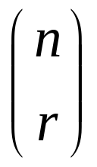
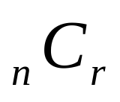
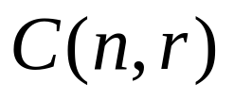
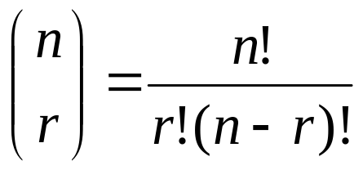
COMBINATION
The combination of n objects taken r at a time is a selection of r objects out of n where order does not count. It is denoted by any one of the following symbols:
or
and is given by the formula

Slide 30
COMBINATION
1. A high school wants to buy 6 computers for its laboratory from a local supplier. The supplier has 10 computers in stock of which 4 are foreign-made.
(a) How many ways are there to buy 6 computers from the supplier;
How many ways are there, if the high school wants 4 domestic and 2 foreign-made computers.
2. In how many ways can a committee of 5 reach a majority decision?
3. Ten people have gathered at a party. Find the number of handshakes when each person shakes hands
with everyone else at the party.

Slide 31
REFERENCES
TEXTBOOKS
Guerrero De Leon, Cynthia R, Cristobal M. Pagoso and George Garcia, FUNDAMENTAL STATISTICS, for College Students, Manila: Sinag Tala Publishers Inc. 1992
Mendenhall, William, Robert J. Beaver and Barbara Beaver,
INTRODUCTION TO PROBABILITY AND STATISTICS, Brooks Cole Publishing Co., 1999
Ross, Sheldon M, A FIRST COURSE IN PROBABILITY, New York: Macmillan New York: Macmillan Publishing Co., Inc., 1978
Spiegel, Murray R. SCHAUM’S OUTLINE OF THEORY AND PROBLEMS OF STATISTICS, 2ND edition: New York: Mc Graw-Hill Publishing Company, 1988
Triola, Mario. ELEMENTARY STATISTICS, 8th Edition, Addison Wesley Longman: Pearson Education 2000
Walpole, Ronald E and Raymond H. Myers, PROBABILITY & STATISTICS
FOR ENGINEERS AND SCIENTIST, 6th Edition. Singapore: Maxwell Macmillan, 2000
WEBSITES:
http://en.wikipedia.org/wiki/Mechanics
http://www.personal.psu.edu/faculty/r/c/rce2/mcht111/111intro.html

